Slide 1
Computer control Using Hand Gestures

Slide 2
Introduction :-
Recently Gesture controlled Laptops or computers are getting very famous.
This technique is called Leap motion which enables us to control certain functions on our computer Laptop by simply waving our hand in front of it.

Slide 3
building our own Gesture control Laptop/Computer by combining the Power of Arduino and Python
We will use two Ultrasonic sensors to determine the position of our hand and control a media player (VLC) based on the position

Slide 4
GESTURE :-
Gesture is usually considered as a movement of part of the body especially a hand to express an idea or meaning.

Slide 5
PRINCIPLE BEHIND THIS project :-
We are Using two Ultrasonic Sensors with Arduino.
The position of the Ultrasonic Sensors is very important.
Place the two Ultrasonic Sensors on the top of a laptop screen at either end.
The distance information from Arduino is collected by a Python Program and a special library called PyAutoGUI will convert the data into keyboard click actions.

Slide 6
Component required :-
Arduino UNO
Ultrasonic sensors
Jumper Wires

Slide 7
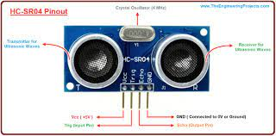
HC-SR04 :-
The HC-SR04 Ultrasonic Distance Sensor is a sensor used for detecting the distance to an object using sonar.
Ultrasonic sensors generate high frequency sound waves & evaluate the echo which is received back by the sensor.

Slide 8
ARUDINO UNO :-
The Arduino UNO is considered as the powerful board used in various projects. Arduino UNO is based on an ATmega328P microcontroller.
> The ATMEGA328P-PN is a popular microcontroller which has 8 bit risc heart of the arduino.
> high performance yet low power consumption .
It is easy to use compared to other boards, such as the Arduino Mega board,etc.
The board consists of digital and analog Input/Output pins (1/0), shields, and other circuits.
The Arduino UNO includes 6 analog pin inputs, 14 digital pins, a USB connector, a power jack, and an ICSP (In-Circuit Serial Programming) header. It can run both online and offline.

Slide 9
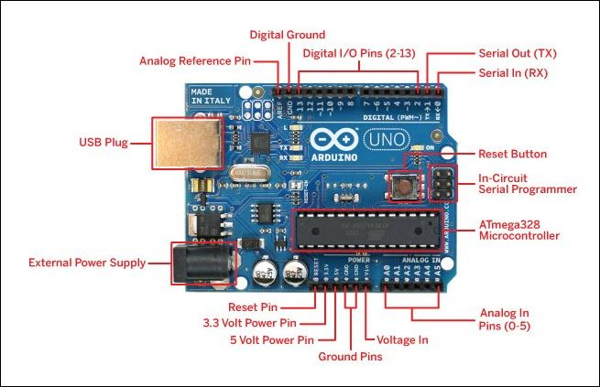

Slide 10
DESIGN OF THE PROJECT :-
The design of the circuit is very simple, but the setup of the components is very important. The Trigger and Echo Pins of the first Ultrasonic Sensor (that is placed on the left of the screen) are connected to Pins 11 and 10 of the Arduino.
For the second Ultrasonic Sensor, the Trigger and Echo Pins are connected to Pins 6 and 5 of the Arduino,
PIN NO 10, 11 ,12 ,13 are (SPI )Serial Peripheral Interface used by microcontrollers for communicating with one or more peripheral devices quickly over short distances. It can also be used for communication between two microcontrollers
PIN no 5 and 6 are analog pins which utilize the analog to digital converter this pins serves as analog input but also function as digital input /output

Slide 11
Now, coming to the placement of the Sensors, place both the Ultrasonic Sensors on top of the Laptop screen, one at the left end and the other at right.
Connect the wires from Arduino to Trigger and Echo Pins of the individual sensors.
Now, we are ready for programming the Arduino.

Slide 12
TASKS PERFORMED :-
Switch to Next Tab in a Web Browser
Switch to Previous Tab in a Web Browser
Scroll Down in a Web Page.
Scroll Up in a Web Page.
Increase Volume
Decrease Volume

Slide 13
HAND GESTURES :-
Gesture 2: Place your hand in front of the Right Ultrasonic Sensor at a distance (between 15CM to 35CM) for a small duration and move your hand towards the sensor. This gesture will Scroll up the Web Page or Increase the Volume.
Gesture 3: Swipe your hand in front of the Right Ultrasonic Sensor. This gesture will move to the Next Tab.
.Gesture 4 SwGesture 1: Place your hand in front of the Right Ultrasonic Sensor at a distance (between 15CM to 35CM) for a small duration and move your hand away from the sensor. This gesture will Scroll Down the Web Page, Decrease the Volume.
ipe your hand in front of the Left Ultrasonic Sensor. This gesture will move to the Previous Tab.

Slide 14
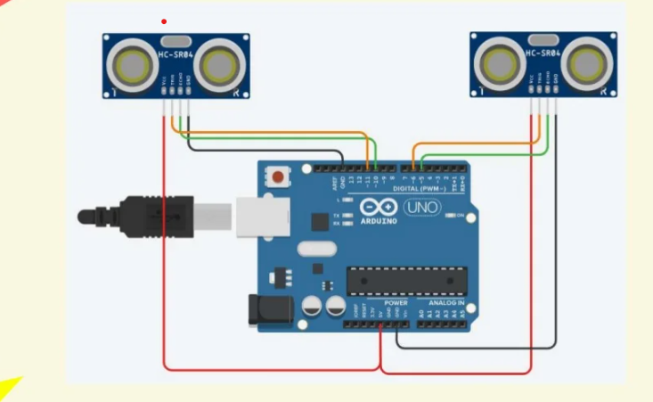
CIRCUIT DIAGRAM :-

Slide 15
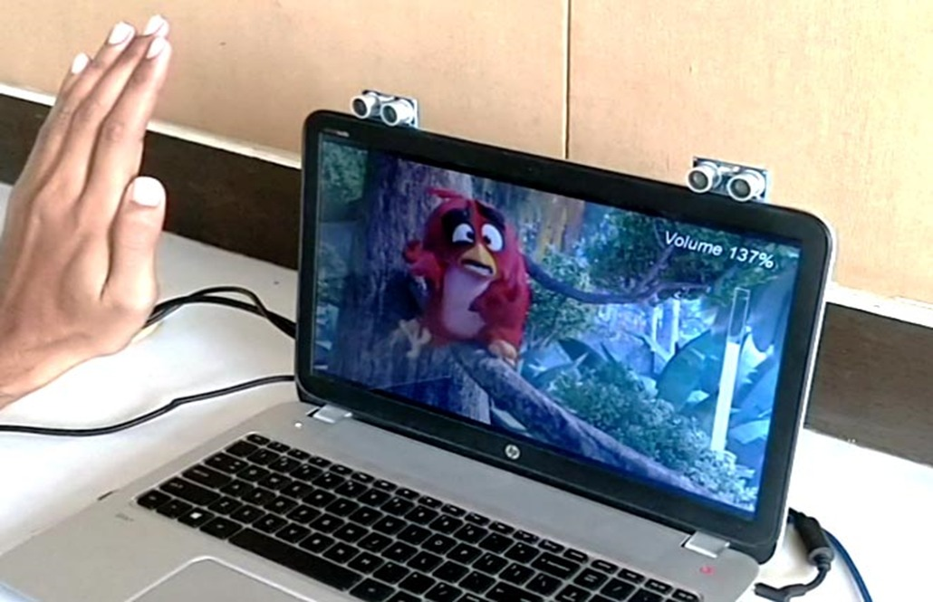
Sample diagram :-

Slide 16
APPLICATIONS :-
Immersive gaming technology : Gestures may be used to control interactions with the gaming console and give a more interactive and immersive experience.
Control through facial gestures: This technology can be used for applications with even more precision like recognizing face gestures. This will be helpful in situations when cannot use other input interfaces like mouse or keyboard or even hand gestures.
Remote control: By using gesture recognition, it is possible to use hand alone as a remote control for various devices.
Home Appliances control: It is possible to extend the gesture recognition technology to control the household appliances.

Slide 17
FUTURE TRENDS :-
Gesture recognition eases the level of handling a broad range of devices such as personal navigation devices, computers, laptops and mobile handsets.
A growing trend towards touchless gesture recognition in niche applications including gaming is likely to amplify the growth of the touchless sensing market over the projected period.
Additional gesture recognition opportunities exist in medical applications where, for health and safety reasons, a nurse or doctor may not be able to touch a display or track-pad but still needs to control a system.
Appropriate gestures, such as hand swipes or using a finger as a virtual mouse, are a safer and faster way to control the device.

Slide 18
Conclusion :-
This project presents one of the solutions among various others, for operating a computer using hand gestures. It is one of the easiest ways of interaction between human and computer. It is a cost effective model which is only based on Arduino UNO and ultrasonic sensor. The python IDE allows a seamless integration with Arduino UNO in order to achieve different processing and controlling method for creating new gesture control solution.

Slide 19
Thank You…

